Slide 1
IRCC11-06.1A
NORDIC HYDROGRAPHIC COMMISSION (NHC)
NHC report to IRCC11
Genoa, Italy 3-5 June 2019
Denmark on behalf of the NHC Chair from Iceland

Slide 2
Outline of NHC
Membership
Chair: Mr Georg Lárusson (IS) from April 2019
Mr Rainer Mustaniemi, (FI) from April 2018
Vice-Chair: Mr Árni Þór Vésteinsson (IS) from April 2019
Mr Jarmo Mäkinen, (FI) from April 2018
Membership:
Members: Denmark, Finland, Iceland, Norway, Sweden
Associate member(s): None
Observers: IHO representative, Secretary General, Dr Mathias Jonas
Current NHC Working Groups:
Nordic Survey Expert Group (NSEG)
Nordic Chart Production Expert Group (NCPEG)

Slide 3
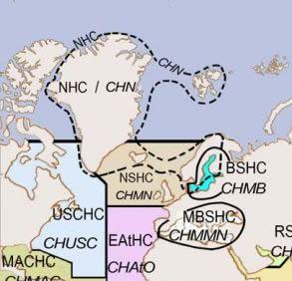
Meetings since IRCC10 (June 2018)
Meetings:
NHC63 in Helsinki, Finland 9-11 April 2019
NHC63 Open session in Helsinki, Finland 11. April 2019
Next meeting (NHC64) will be in Reykjavik, Island, March 2020.

Slide 4
Activities
The main subjects dealt with during the reporting period:
- Status and development plans of
nautical publications
- E-Navigation and future needs for improved
hydrographic services and Standards
- Outcome of the Nordic strategic workshop.
- Marine Spatial Data Infrastructure
- Nordic Chart Production. Development of new
chart production systems
- Validation of Chart Production Tools
- Development of new Bathymetric Database
- IHO EU network
- Outcome of WENDWG9
- Digital products for the leisure market
- S-100 product developments
- RENC operations
- New Routeing System in Kattegat
- Harmonized chart datum
- Crowd Source Bathymetry- Seabed 2030
- Data Policy for HO’s
- Reorganisation in HO’s
- Open session for industry
- Selection of the Council member.

Slide 5
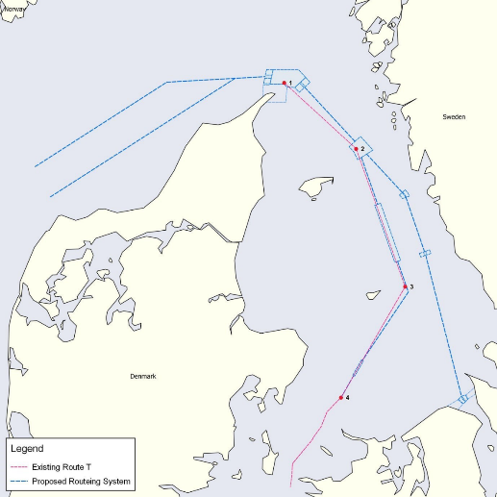
Activities - New ship route system -
New ship route system in the Skagerrak and Kattegat
The maritime authorities in Denmark and Sweden have since 2008 worked closely together on a major route initiative in order to increase navigational safety in the Skagerrak and Kattegat.
A modern ship routing system can reduce the risk of accidents and oil spills, thus protecting the marine environment. IMO gave the final approval in May 2018 with implementation on July 1, 2020.
https://www.iho.int/mtg_docs/rhc/NHC/NHC63/NHC63_2019_C.1.3_White_paper_New_shi p_route_system_DK.pdf

Slide 6
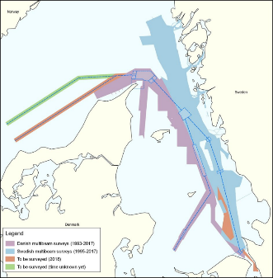
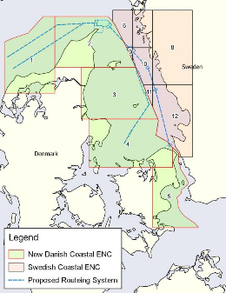
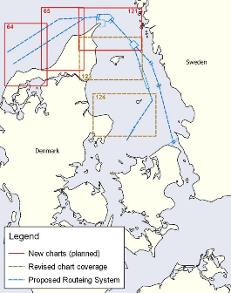
Activities - New ship route system -
The implementation date of the routing measures will be 1 July 2020.
This date allows sufficient time to complete hydrographical surveys, production of new charts, and to inform ship traffic thoroughly in due time.
There is a need for new and updated paper charts and ENCs in the concerned area, and to synchronize depth information, such as specific depth contours between Danish and Swedish waters.
The hydrographical authorities in Denmark and Sweden are allocating resources for this matter.
Changes in Kattegat
The International Maritime Organization (IMO) has decided to establish a new routeing system in Kattegat and the northern part of The Sound from 1 July 2020.
The intention is to reduce the large number of ships in the existing Route T by establishing a new recommended route, Route S, along the Swedish coast from Læsø
Island to The Sound.
Along Route S, three traffic separation schemes will be established in order to separate north- and southbound traffic. Vessels to and from The Sound shall use Route S
and vessels to and from the Great Belt shall use Route T.
The existing Route T will change slightly when the new routeing system comes into force.
What are the consequences?
……….

Slide 7
Activities - Digital products for the leisure market -
Questionnaire to the NHC MS about nautical digital products for the leisure market.
Generally most of the different NHC MS have a different approach to the leisure market, e.g. how they focus on digital products, legistration, distribution and financial model. => From a user perspective that means commercial companies and especially new companies that want to sell digital products for the leisure market it seems to be rather complicated.
NHC discussion:
How to make it easier from a regional perspective for private companies to get access to and sell digital products
HOs approach to: user requirements of leisure craft market
Best practice of distribution and use of electronic charts/data to the leisure market
Best practice of royalty models
Short term result:
To prepare a NHC information paper about the different licenses models for the leisure market.

Slide 8
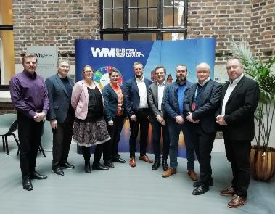
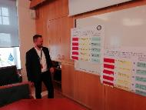
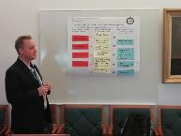
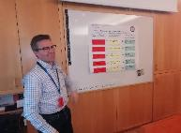
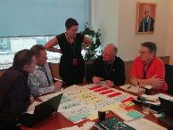
Activities - NHC strategic workshop -
NHC strategic workshop - The future role of the Nordic Hydrographic Offices
The aim of the NHC strategic workshop was to establish a strategic framework for the NHC MS in a Nordic perspective within the timeframe 2026/30 and to harmonize strategic milestones towards 2030.
Before the workshop each NHC MS had to prepare a presentation and to complete a questionnaire about the present status and expectation for the future.

Slide 9
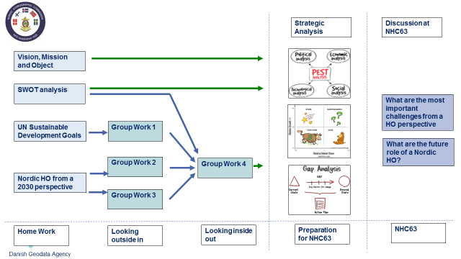
Activities - NHC strategic workshop -

Slide 11
In order to develop the Nordic strategic approach and to concretize the results from the discussion the NHC63 meeting agreed to continue the strategic process and to arrange a NHC Strategic workshop in Norway in January 2020.

Slide 12
Action requested to IRCC
NHC53 Conclusions:
Member states to follow IHO Res2/1997 recommendations in their national reports to RHC.
Nordic member states to establish CATZOC policies and provide information to DQWG
To make a proposal (Sweden) to WENDWG about extended buffer limit for ENC overlaps (today 5 m), especially in smaller scale bands (1, 2 and 3).
Achievements and lessons learned
White paper- New Ship Route System in Kattegat (1 July 2020.
To prepare an information paper about different licence models about data for leisure market.
Related to IHO strategy review to prepare and send common questionnaire to the end users on their future requirements.
The IRCC is invited to note this report.

